Slide 1

VIX Index Based Retail Trader Tool
Rajeev Panwar
This Photo by Unknown Author is licensed under CC BY
Notes:
Good morning - Im here to pitch the VIX index based retail trader tool today - And to start with I would like to comment on the current investment reality

Slide 2
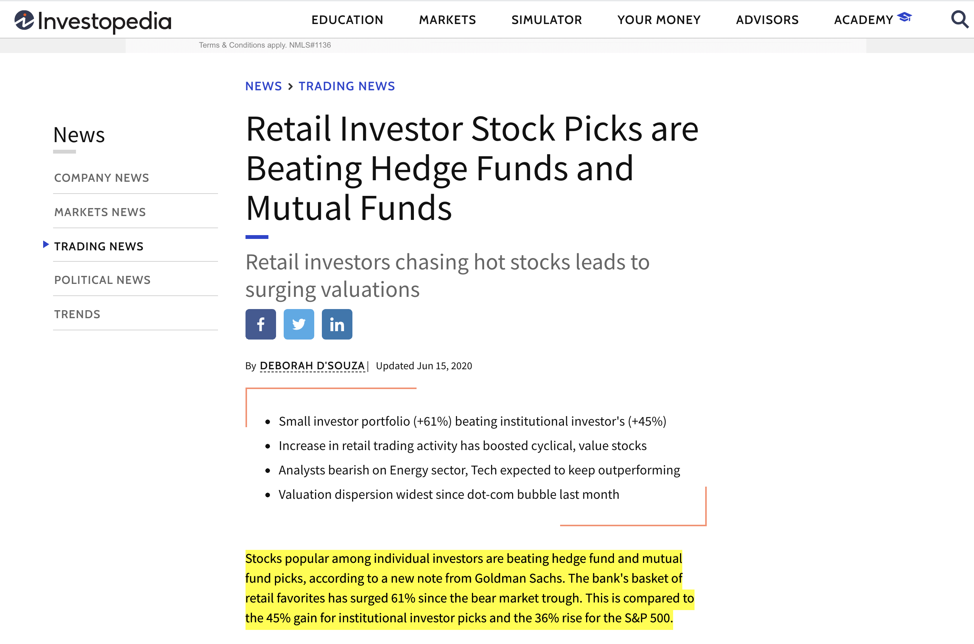
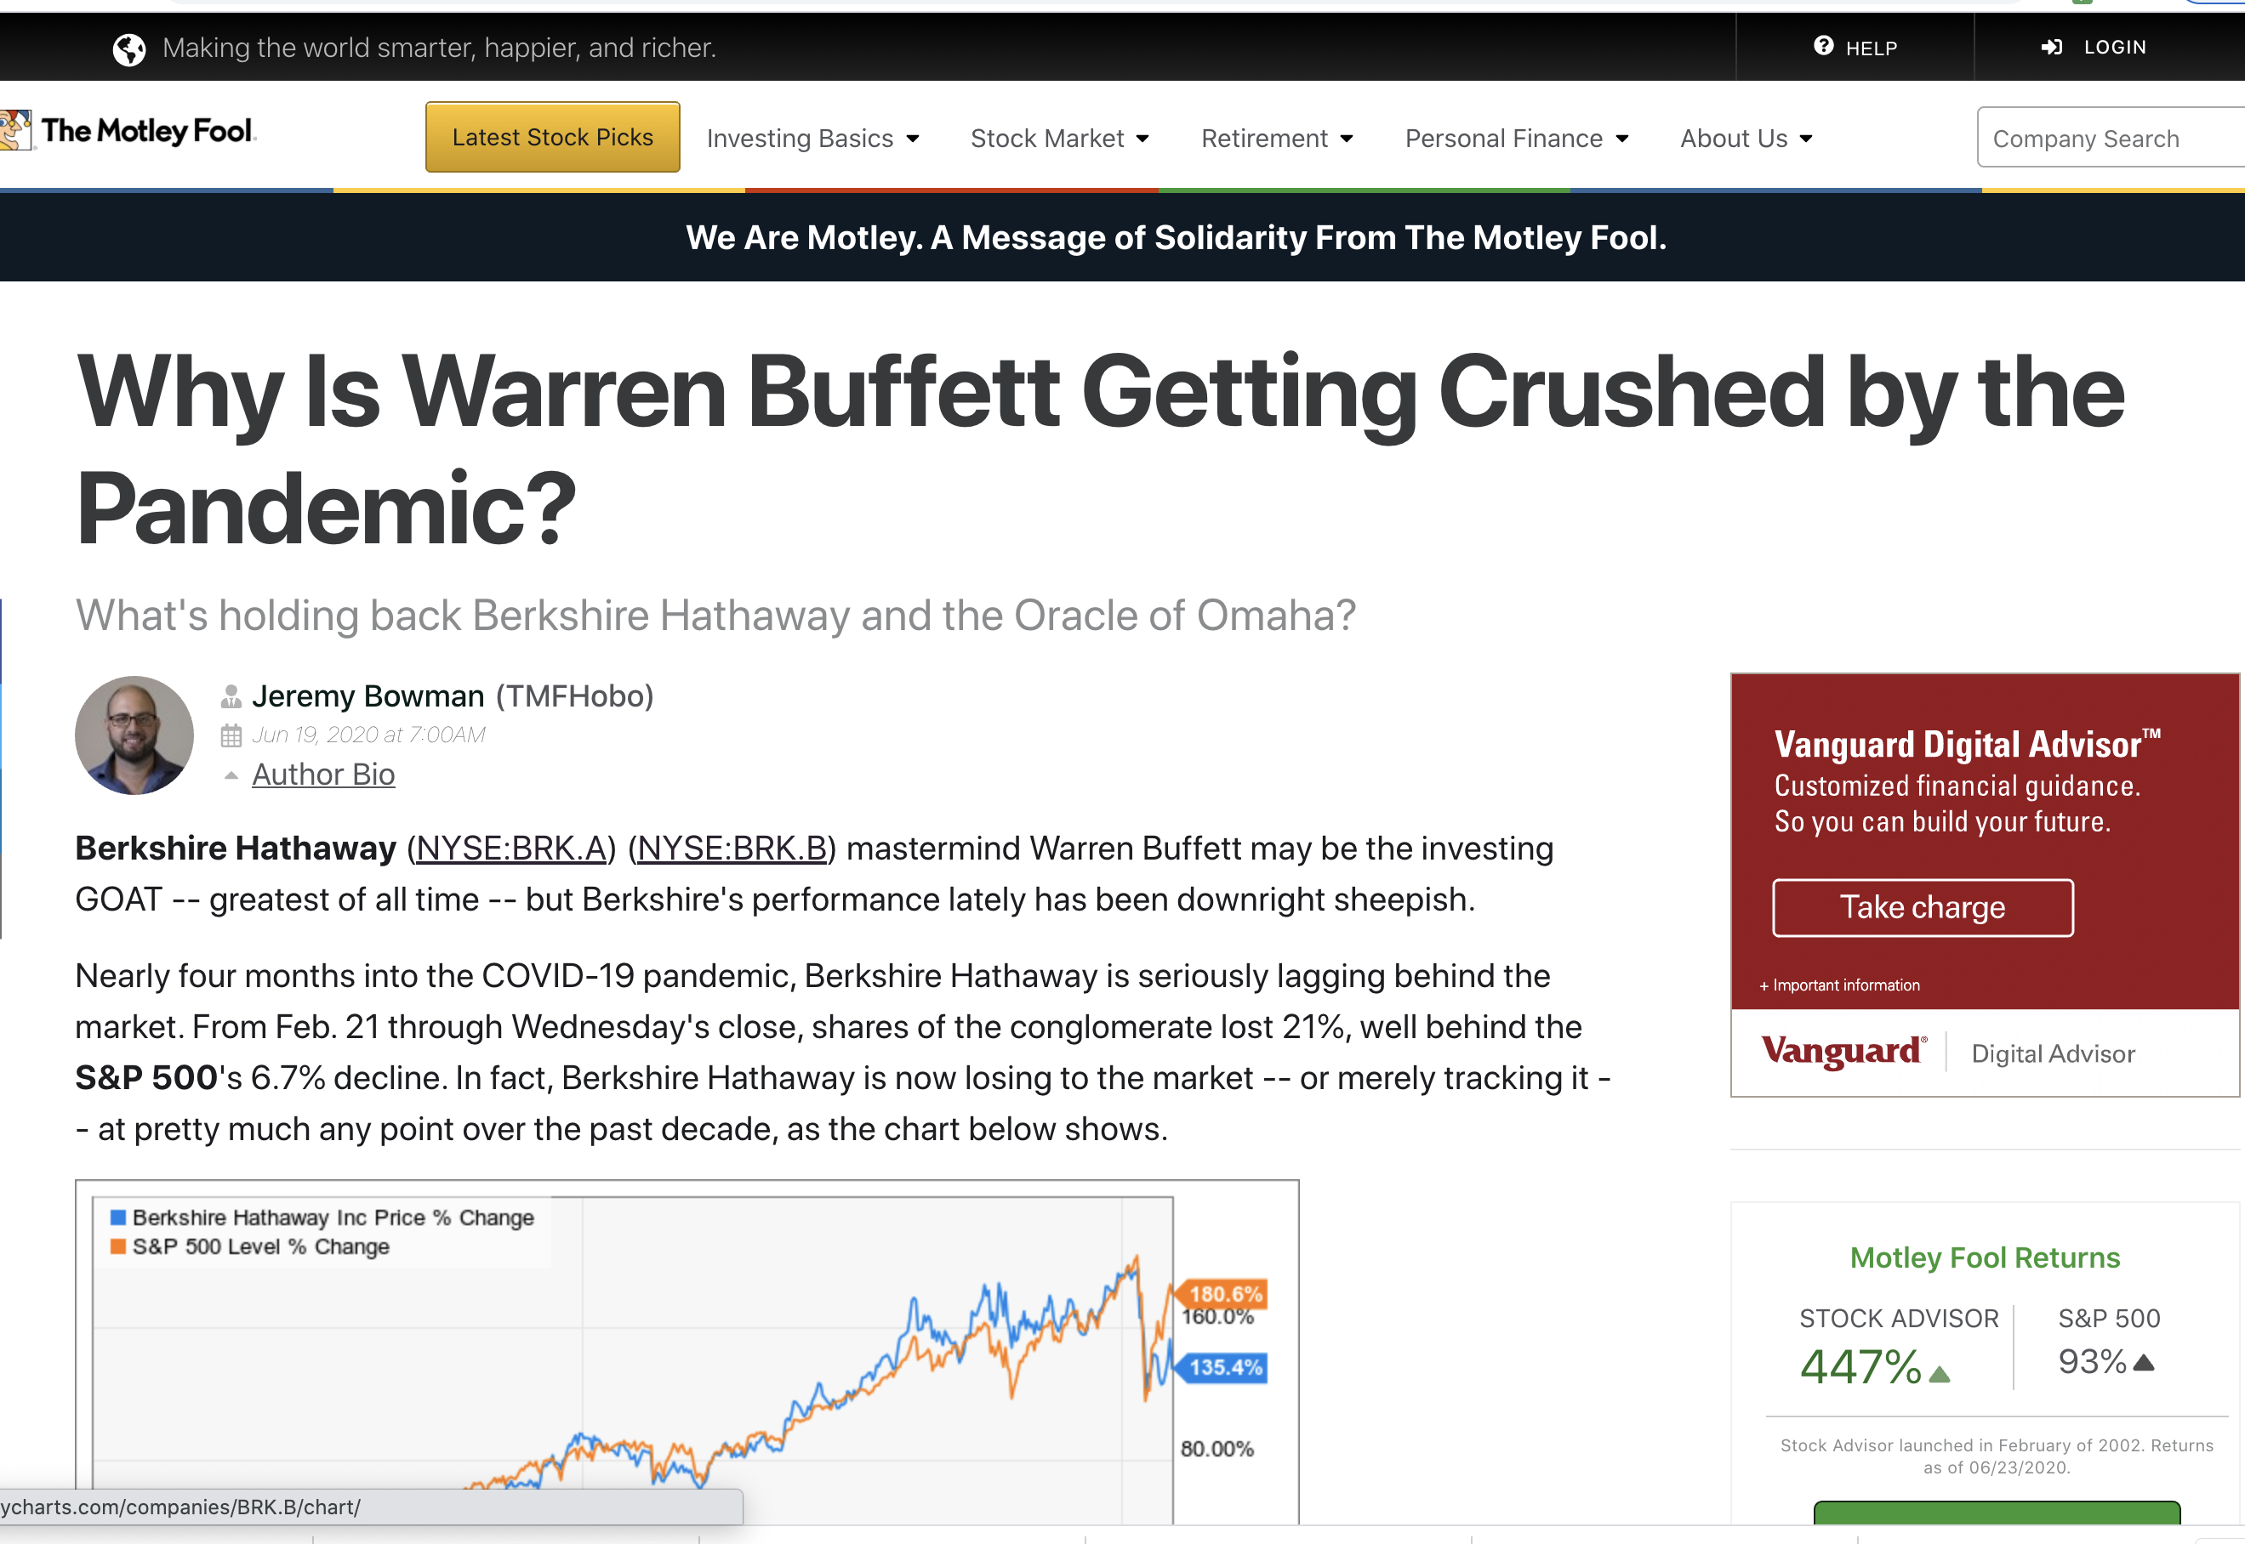
current investment reality
Clearly a new breed of ‘smart’ mom/pop traders are starting to dominate Wall Street!

Slide 3
beware danger lurks!
Competing against Machine Learning Trading Algorithms that feed of real time volatility data – ‘computational outmatched’
Market Volatility – Friend or Foe?
Notes:
Depends on which kind of trader you’re talking to

Slide 4
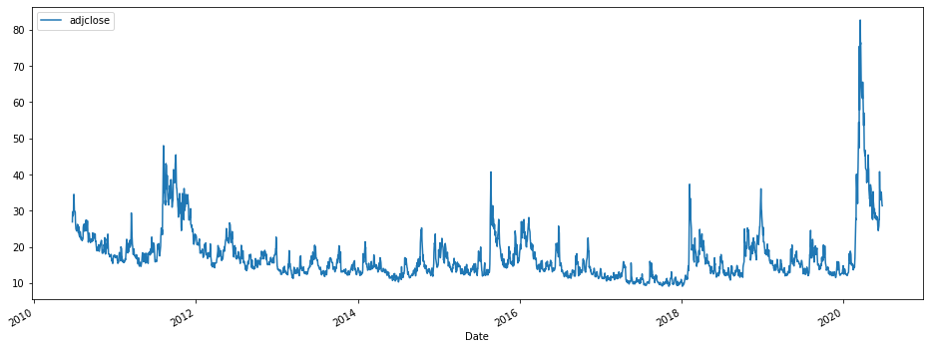
Volatility Index (VIX) aka ‘fear gauge’ or ’fear index’
VIX Index | 16 | 25 | 35 | 45
Implied Annual % | 16% | 25% | 35% | 45%
VIX Index | Mean | SD | 50% | 75% | Max
Key Facts | ~17 | ~7 | ~15 | ~19 | ~82
Covid-19
Mid-term election –
2012
Election Year & Big Tax Cut
Index Value
Trade War & Iran Crises
Year
Widely acknowledged as the best indicator of implied future volatility (for over 25 years)
Challenge – CBOE VIX is for most part inscrutable to the retail mom/pop investor
Key characteristic - ‘long term mean reversion’

Slide 5
the process (MVP)
Develop trading strategy tool to alert retail investor on expected % movement over predicted time period ‘t’ (Final Product)
5
Complete - LSTM
Stretch goal – identify key thresholds for development of alert system
4
MVP
Time series forecast VIX using a baseline model, ARIMA & PROPHET – Evaluation Criteria - RMSE
3
Exploratory data analysis
2
Web-scraped historic daily adjusted closing price from Yahoo Finance – 10 years of VIX Index prices ~ 2517 observations
1

Slide 6
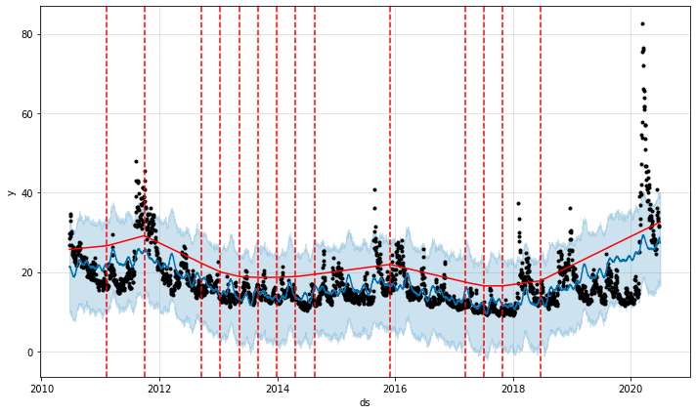
Verifying Key Changepoint Using Prophet
Covid-19
Mid-term election –
2012
Trade War & Iran Crises
Election Year & Big Tax Cut
Index Value
Year

Slide 7
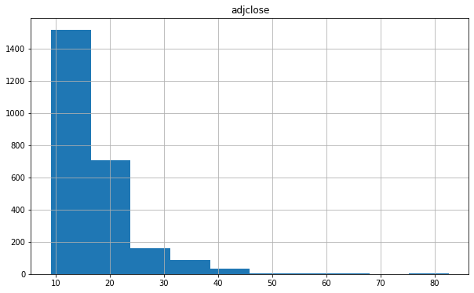
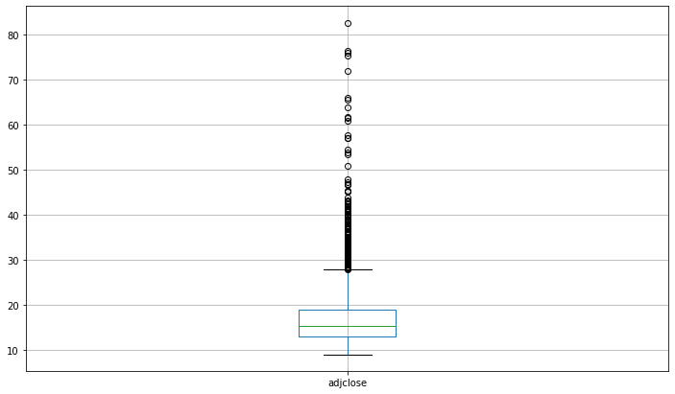
How frequently do investors tend to panic!
Number of Observations
Index Value
Thank-fully Institutional investors seem to be pretty level-headed for the most decade

Slide 8
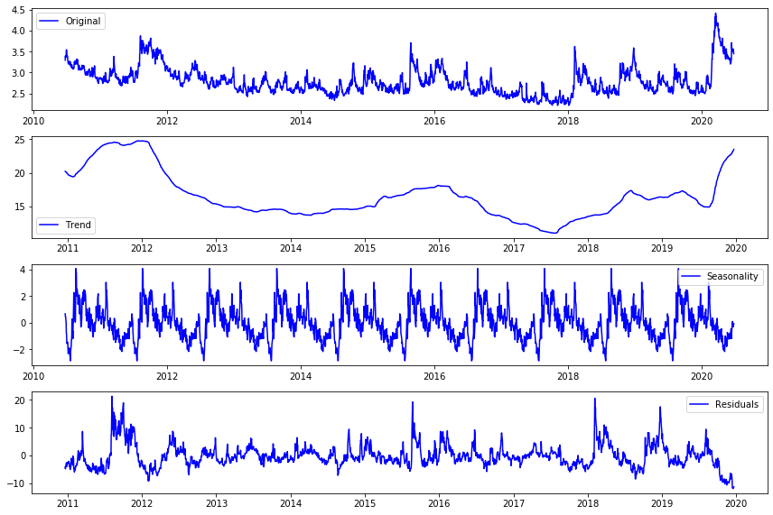
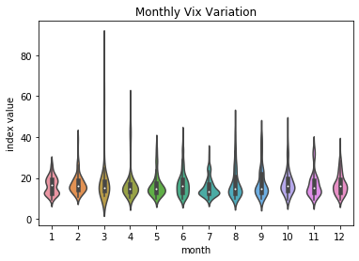
Interesting Findings!
End of Q1 & Q2 seem to experience more volatility than the latter half of year – Q2 2020 is coming up! Buckle up!!!

Slide 9
Baseline Model
End of Q1 & Q2 seem to experience more volatility than the latter half of year – Q2 2020 is coming up! Buckle up!!!

Slide 10
Prophet
End of Q1 & Q2 seem to experience more volatility than the latter half of year – Q2 2020 is coming up! Buckle up!!!

Slide 11
ARIMA
End of Q1 & Q2 seem to experience more volatility than the latter half of year – Q2 2020 is coming up! Buckle up!!!

Slide 12
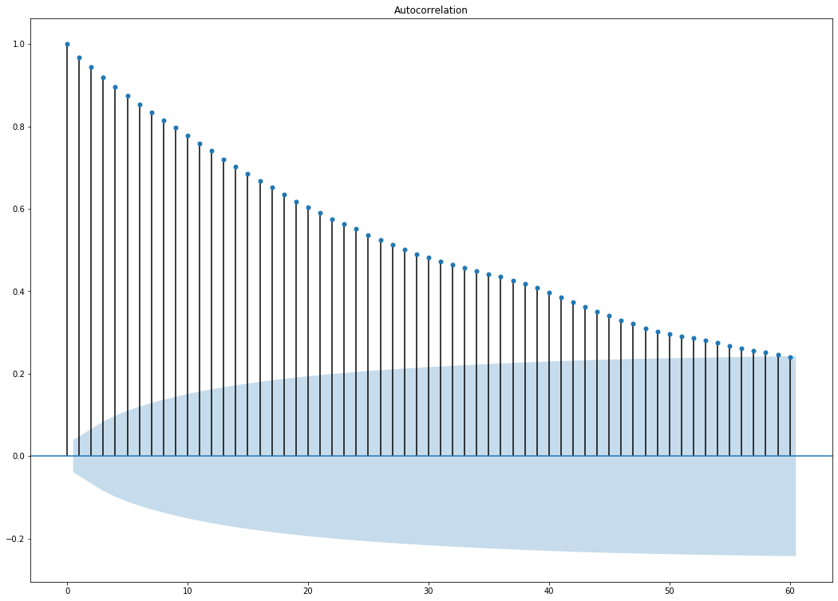
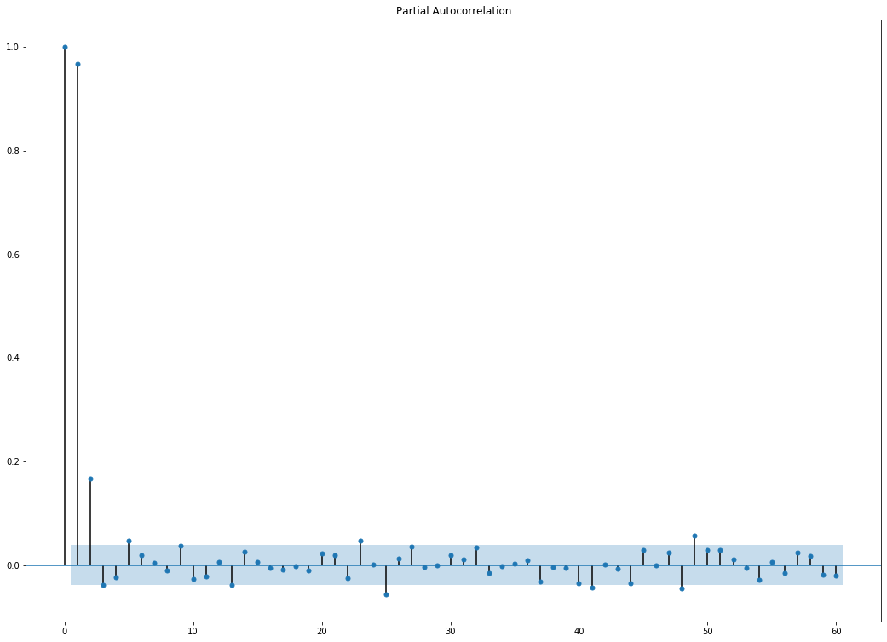
Interesting Findings!
End of Q1 & Q2 seem to experience more volatility than the latter half of year – Q2 2020 is coming up! Buckle up!!!

